Slide 1
What is compilation / recompilation?
A compilation is the process when a stored procedure’s query execution plan is optimized by the optimizer. Once the optimizer completes, the compiled execution plan is saved in the cache

Slide 2
The purpose of the Query Optimizer
A query optimizer is a SQL component that analyzes SQL queries and generates multiple execution plans and then selects the most efficient plan
Each of these SQL statement, be it simple or complex, requires minimal use of valuable resources, such as disk reads, CPU usage and server memory

Slide 3
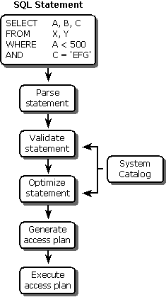
Query optimizer steps

Slide 4
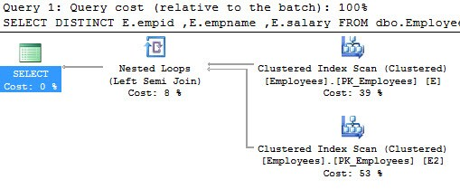
Example of a sproc compiling and execution plan
It goes to the cache to see if there is an execution plan: If not it will go to disk to get the data
Cache (memory)
1st time a
sproc is executed
Stored
Procedure
1st time a sproc is executed:
Gets the data from disk
Disk
1. Sproc is executed
2. Optimizer creates an execution plan
3. Optimizer checks cache for existence of plan
4. If not in cache, it will go to the disk to find data
5. This first time creation of an execution plan is compiling

Slide 5
Example of a sproc compiling and execution plan
It goes to the cache to see if there is an execution plan: DOES EXISTS
Cache (memory)
Sproc
2nd time a
sproc is executed
Stored
Procedure
Disk
1. 2ND time Sproc is executed
2. Optimizer creates an execution plan
3. Optimizer checks cache for existence of plan
4. If DOES EXIST in cache, it will NOT go to the disk to find data
5. Execution plan is saved in cache for reuse

Slide 6
What is recompilation?
A recompilation is the same process as a compilation, just executed again
Recompilation occurs when the database structure or data change significantly causing a new query execution plan to be reproduced
This recompilation degrades SQL Server performance as it’s not using the cached execution plan
Queries are reused, but their query execution plan is not

Slide 7
Example of a sproc recompiling and execution plan
It goes to the cache to see if there is an execution plan: DOES NOT EXISTS
Cache (memory)
Sproc
DIFFERENT EXECUTION PLAN
CHANGE OR MODIFICATION IN SPROC
Stored
Procedure
Disk
1. Sproc is executed WITH MODFICATION
2. Optimizer creates ANOTHER execution plan
3. Optimizer checks cache for existence of plan
4. If DOES NOT EXIST in cache, it will NOT go to the disk to find data
5. Execution plan is saved in cache for reuse

Slide 8
What is the plan cache?
The part of the memory pool that is used to store execution plans is referred to as the plan cache. There are many type of plan cache. The one we will focus on is the SQL PLAN
Plans are cached for possible reuse opportunities. If a query plan is not even cached, its reuse opportunity is zero.
Such a plan will be compiled every time it is executed, resulting in poor performance.

